Slide 1




Debdip Bandyopadhyay
M22AI845

Slide 2
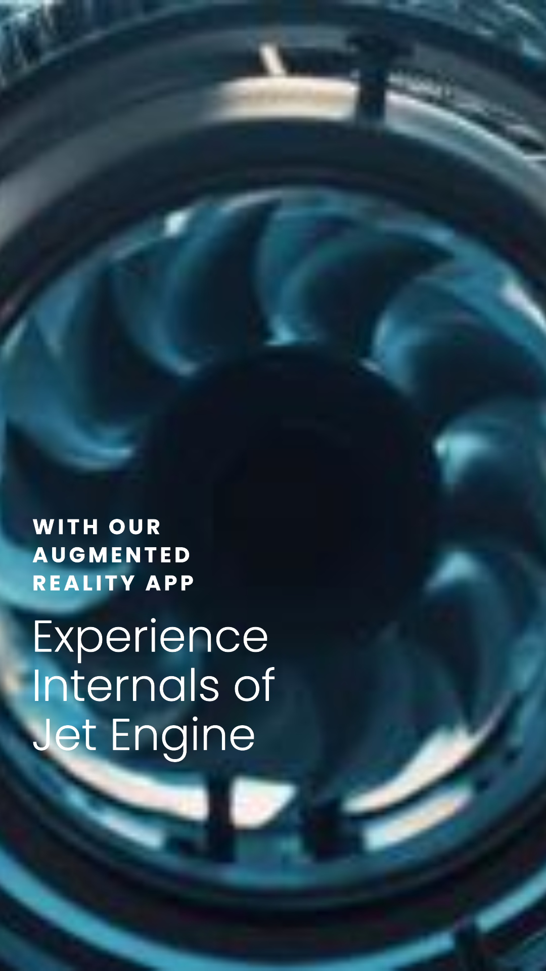
Jet Engine AR app provides an immersive learning experience by allowing users to interact with a virtual jet engine.
Key Features
Interactive 3D Model: Explore a detailed 3D model of a jet engine, with the ability to Augment and dissect the 3D engine model.
Real-time Animation: Watch the jet engine come to life with real-time animation.

Slide 3
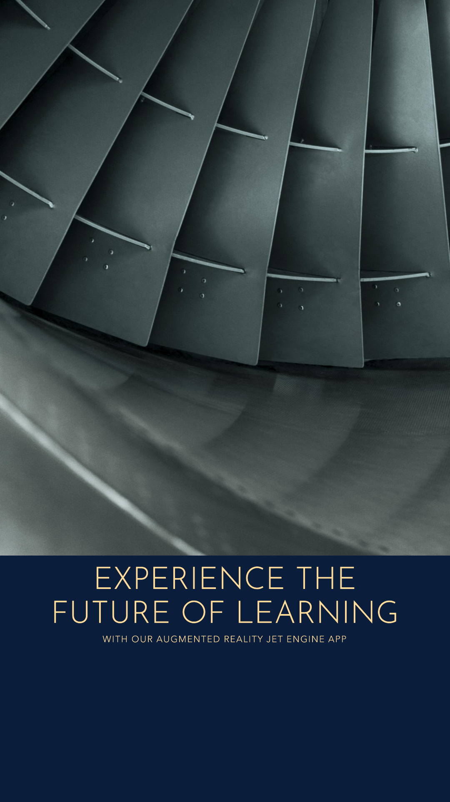
Benefits
Engaging Learning: Makes learning about jet engines fun and engaging.
Deep Understanding: Helps in gaining a deep understanding of the working of a jet engine.
Ability to augment a JET engine inside a room.
Target Audience
Students: Ideal for engineering students or anyone with an interest in learning about jet engines.
Professionals: A great tool for aviation professionals for training and reference.
Aviation Enthusiasts: Perfect for aviation enthusiasts who want to understand the mechanics of flight.

Slide 4
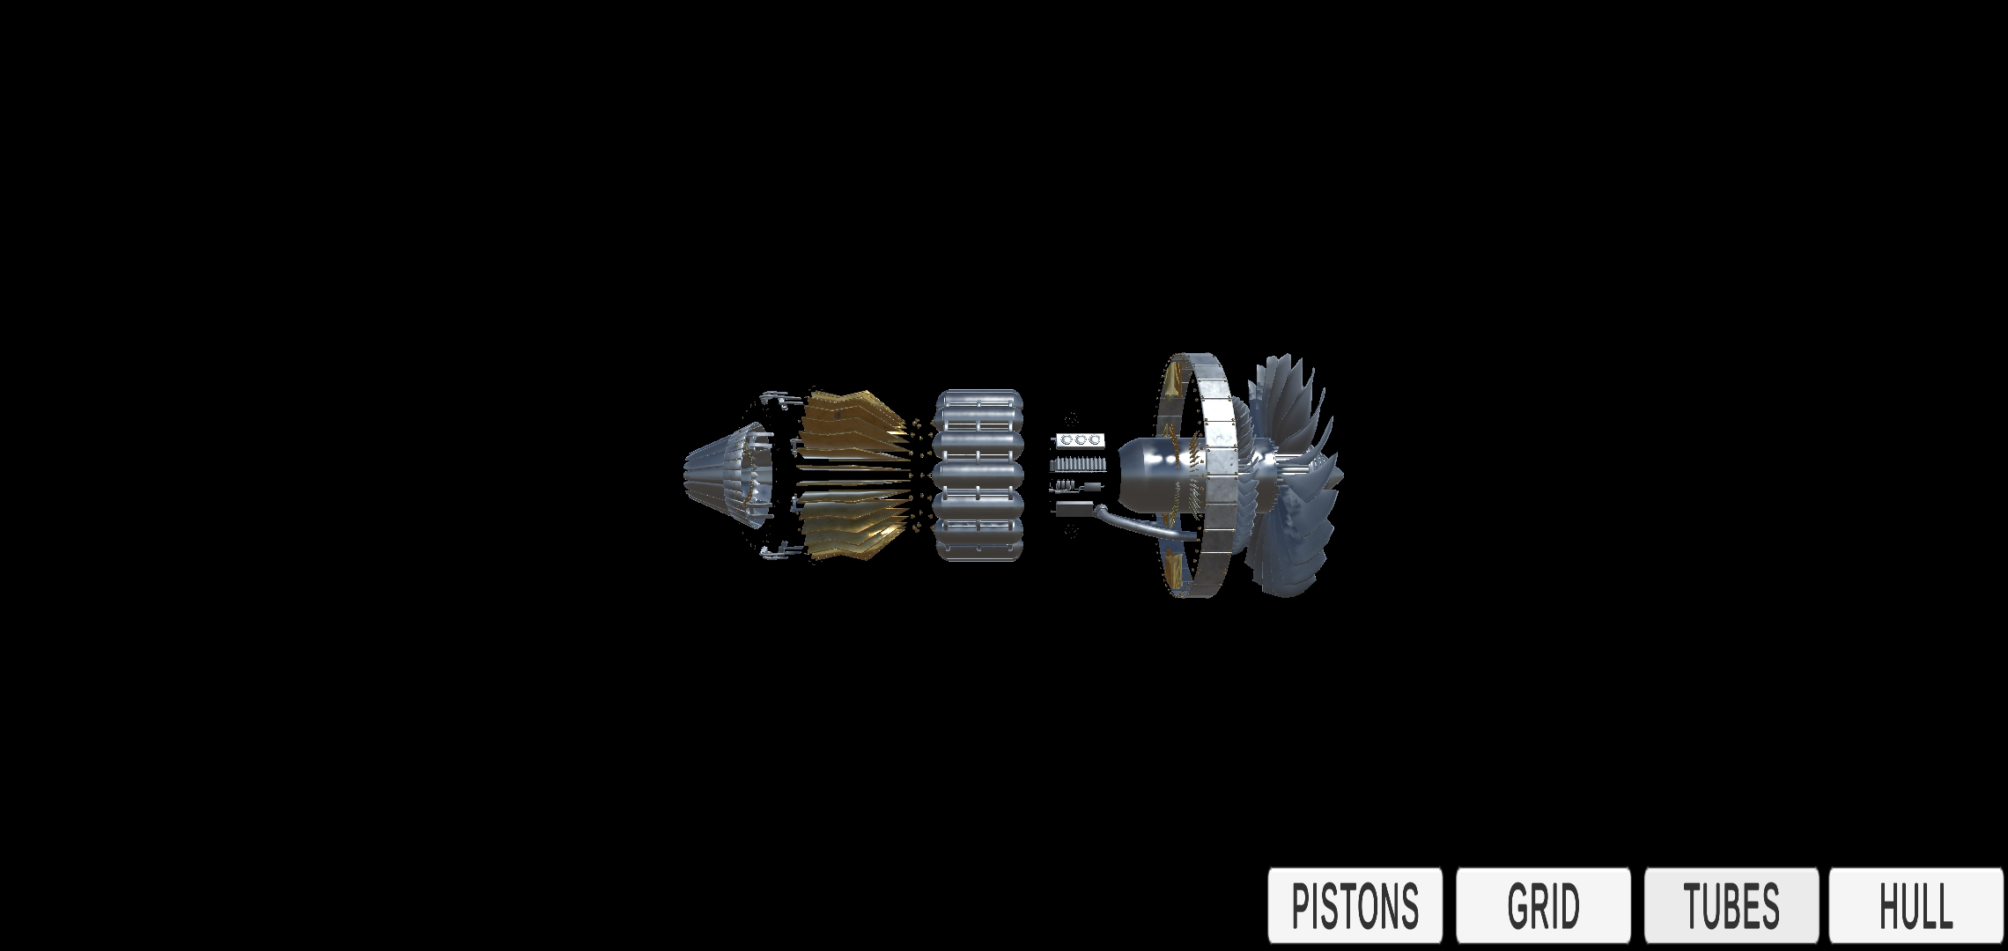
Background of room post Augmenting
Model of an Engine
Piston button
Hull button
Tubes button
GRID button

Slide 5
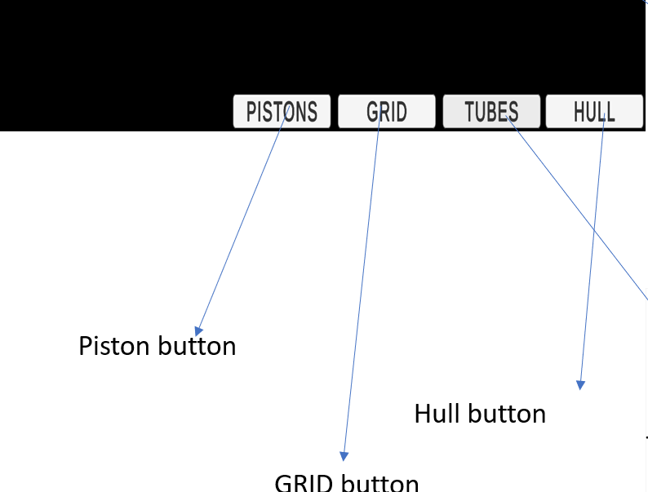
User can remove various component of the engine using these buttons .
This will help the user to understand the turbine engine in much more simpler way.
Say if we want to see the tubes part of the engine we can click on pistons grid and hull button this will only show the tubes with in the engine.
Likewise we can see other components too.

Slide 6
Thank you
Video Demo

